Slide 1
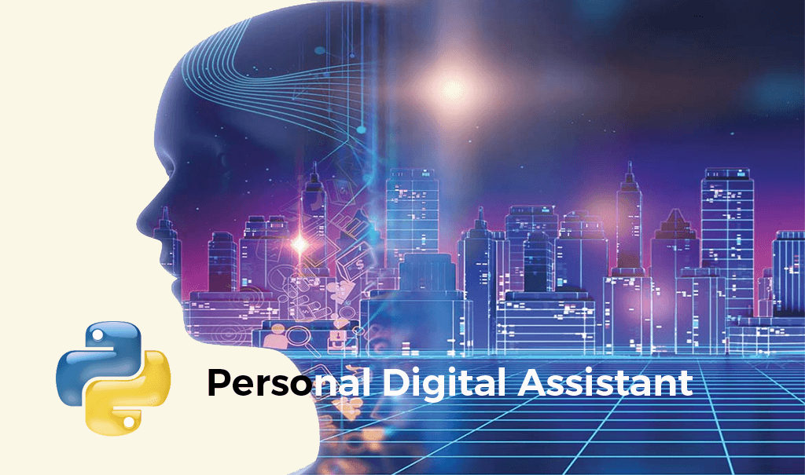

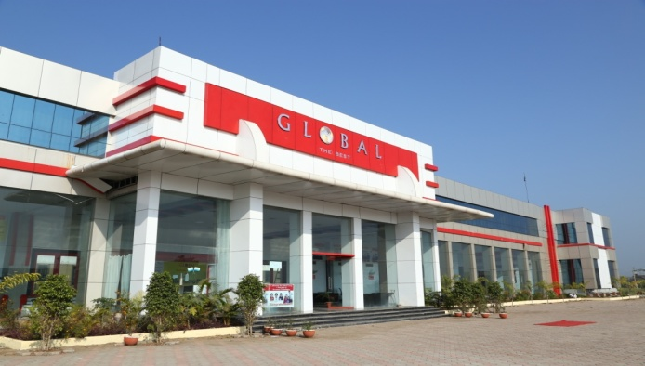
Virtual Assistant
This Project is submitted to Rajiv Gandhi Proudyogiki Vishwavidyalaya, Bhopal, Madhya Pradesh
Global Nature Care Sangathan’s Group Of Institutes , Jabalpur
Submitted by –
Shreyash Tamrakar 0225IT191056
Devansh Nema 0225IT191026
Amit Singh 0225IT191008
Submitted to –
Prof. Saurabh Sharma Sir

Slide 2
Table of Contents – 1.Introduction 2.Languages and Technologies used 3.Features 4.Working 5.Software Tools 6.Hardware Specifications 7.Deployment 8.Advantages 9.Scope 10.Conclusion

Slide 3
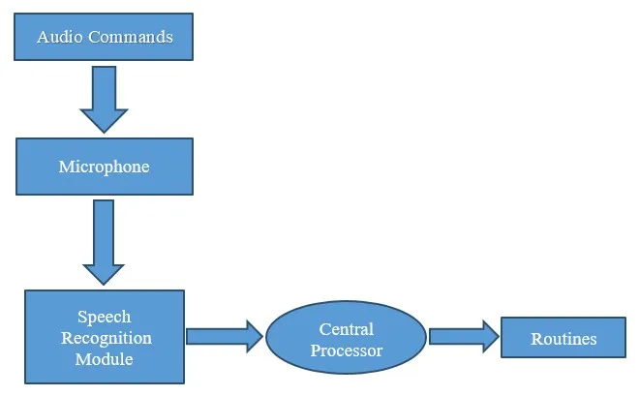
Introduction – Today the development of artificial intelligence (AI) systems that can organize a natural human-machine interaction (through voice, communication, gestures, facial expressions, etc.) are gaining in popularity. Virtual assistants are one of the AI based software programs that help you ease your day to day tasks, such as showing weather reports, creating remainders, making shopping lists etc. They can take commands via text (online chatbots) or by voice. Voice-based intelligent assistants need an invoking word or wake word to activate the listener. It’s not very complicated and can be easily achieved in Python. Personal digital assistants are capturing a lot of attention lately. With growing advancements in artificial intelligence, training the machines to tackle day-to-day tasks is the norm.Voice based personal assistants have gained a lot of popularity in this era of smart homes and smart devices.

Slide 4
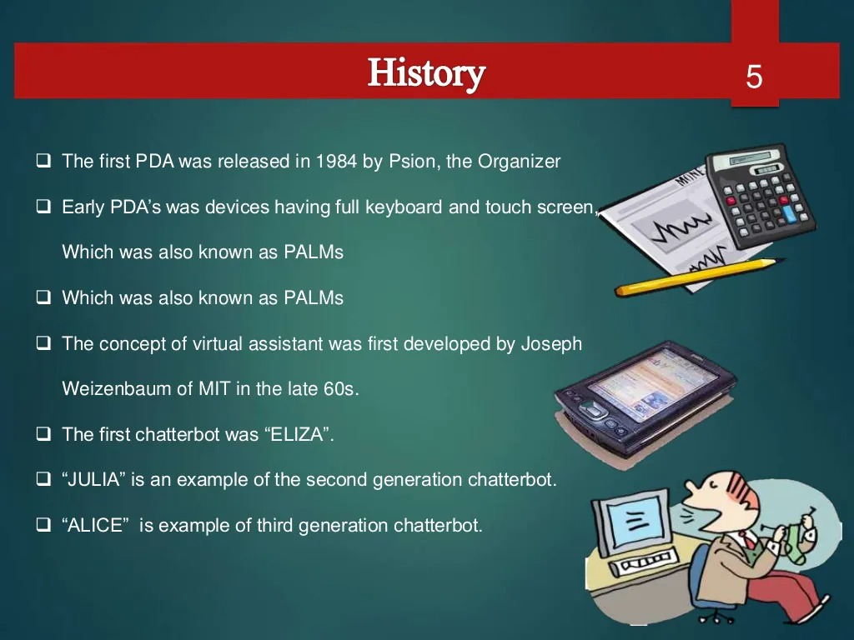

Slide 5
Languages and Technologies used – languages – Core Python – Python is an interpreted, object-oriented, high-level programming language with dynamic semantics. ... Python's simple, easy to learn syntax emphasizes readability and therefore reduces the cost of program maintenance. Python supports modules and packages, which encourages program modularity and code reuse. Technologies – AI GUI – A graphical user interface (GUI) is a type of user interface through which users interact with electronic devices via visual indicator representations. API – An API (Application Programming Interface) is a set of operations a software component (i.e., a system, a sub-system, class, or a function) provides to its clients. For example, we use the API of the String class provided by Python library in our programming.

Slide 6
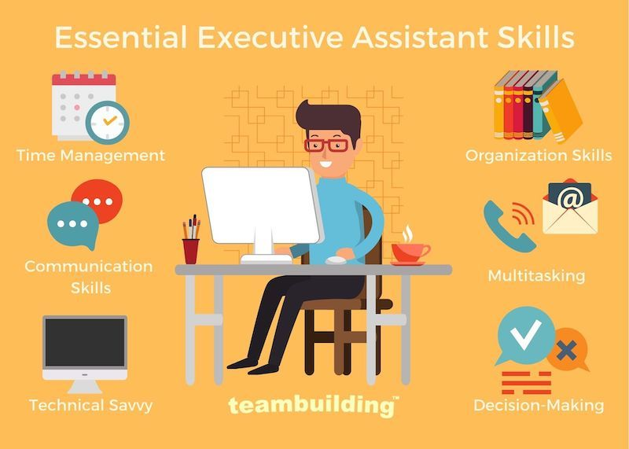

Slide 7
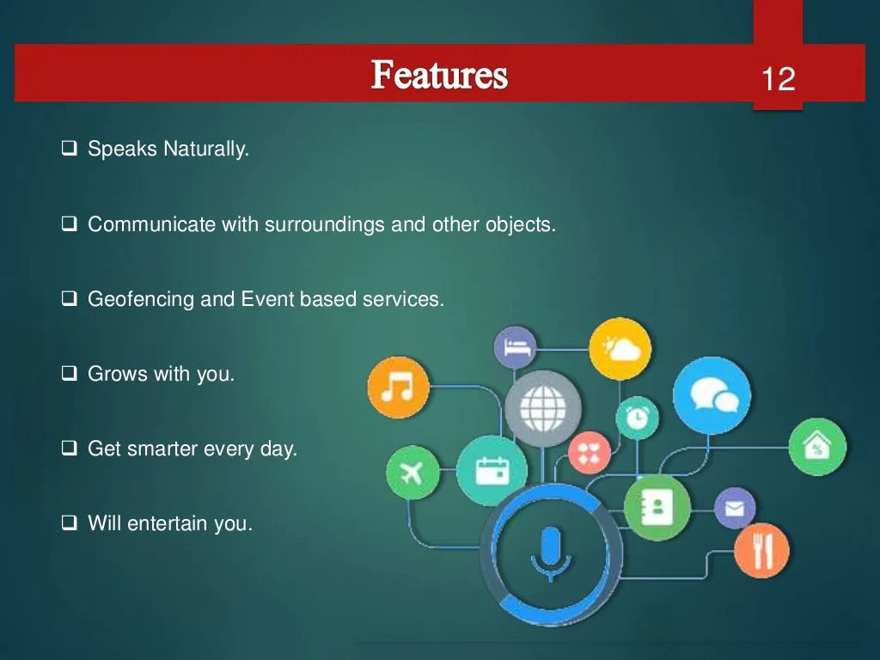

Slide 8
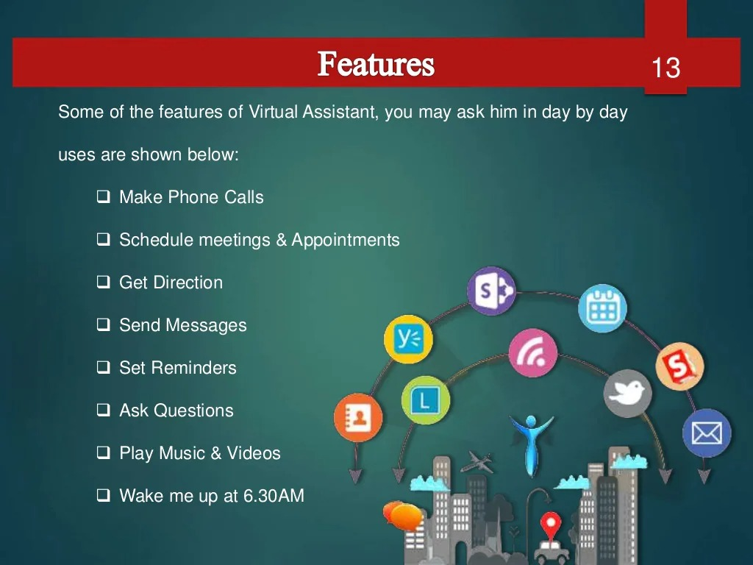

Slide 9
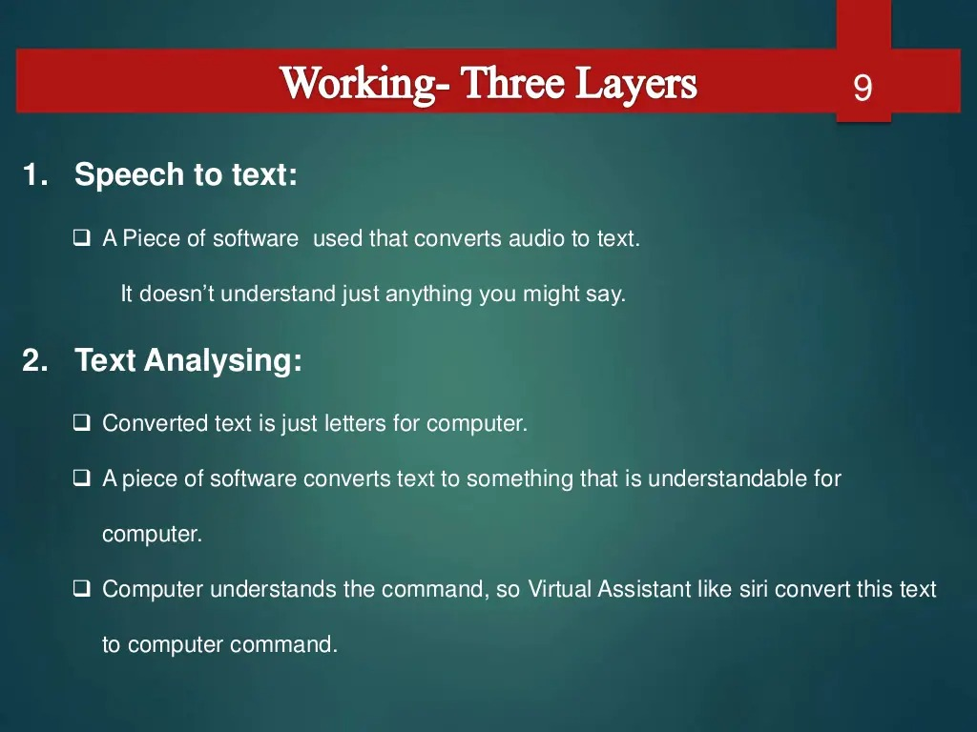

Slide 10
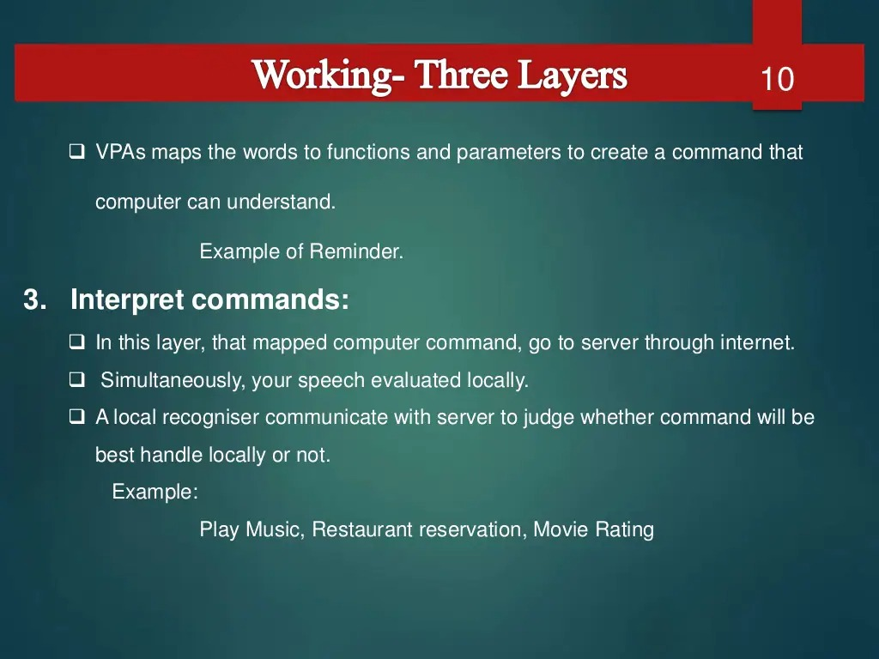

Slide 11
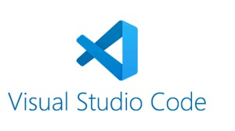
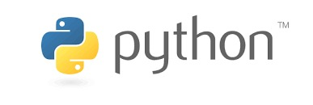

Software Tools – Visual Studio Code(VS code) Python Software(Version 3.10.0) QT designer(App) Hardware Specifications – Winsdows Operating System Intel Core i5 10th Gen 4GB Ram 64-bit 1TB Hard Disk

Slide 12
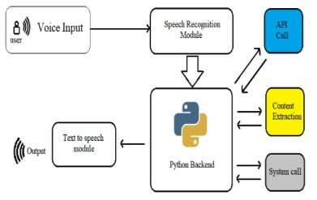
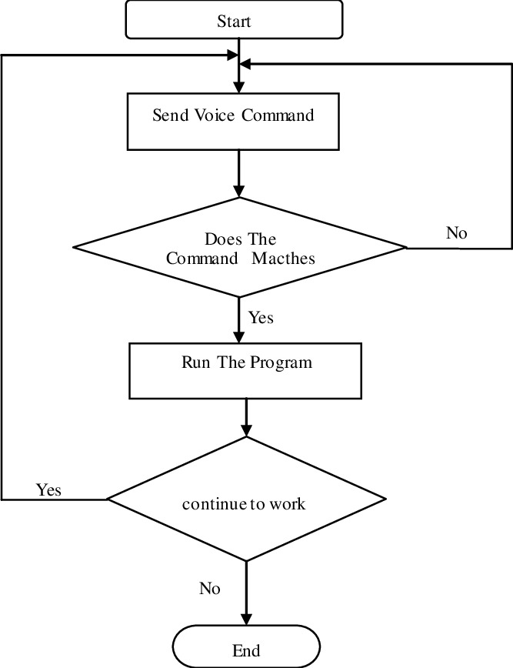
Virtual Assistant Life Cycle –

Slide 13
Deployment – If any other or Client want to execute this virtual Assistant Software using Python in his/her system, they must have following least specifications in their system -: a. 2 GB RAM b. 5 GB Free Space in internal memory c. Modern Operating system d. 2 GB graphic card e. Normal Processor is required

Slide 14
Advantages – 1. It saves time. 2. User perform multiple tasks at the same time. 3. This software is most useful for ‘specially abled’ people. 4. People can do their work by staying away from their system. 5. Encouraging users to spend less time facing display screens. 6. There is no need for user to work sitting in one place for a long time.

Slide 15
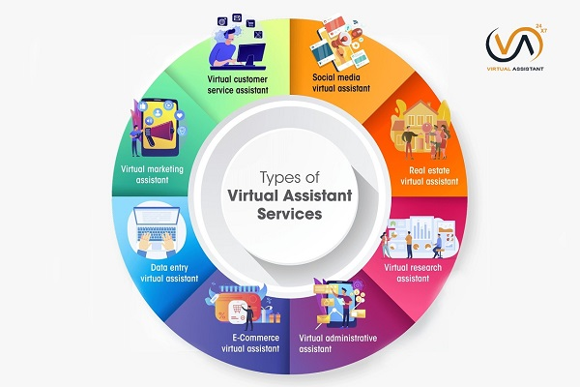
Scope – In IT sector In Marketing In Education In Society In Medical Field And it is useful for many other sectors…

Slide 16
Conclusion – This is how simple it is to build our own voice assistant. You can add many more features such as play your favorite songs, give weather details, open email application, compose emails, restart your system, etc. You can integrate this Software into System as well. We will add more features to this software in future and try to make it even more innovative. The entire Coding is in python and additional features are created by using GUI..

Slide 17
Thank You

